Slide 1
Game Development 2B
Graphs

Slide 2

networks
Graphs (or networks) can be used to model a variety of things
More graph structures have come to prominence in the 20th and 21st century
What are they?

Slide 3
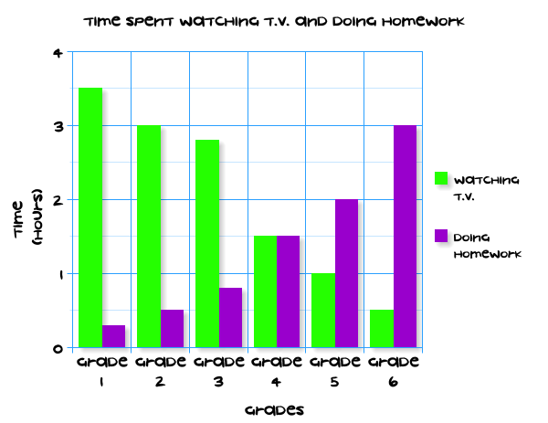
A graph is not a graph
This is not a graph
A graph is a series of vertices connected by edges
Each vertex is a node
Each edge represents a relationship between two vertices – it can be unidirectional (one way) or bidirectional depending on the graph
Edges can also have weights
This Photo by Unknown Author is licensed under CC BY-NC

Slide 4
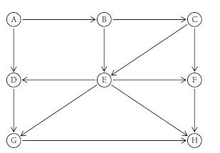
Directed graphs
Edges are one-directional – Edge AB connects A to B, but not B to A
In a normal graph, an edge AB would connect both AB and BA
A path is a sequence of vertices connected by an edge (ABCFH)
Path length is the number of edges
Paths that connect back to the origin are called cycles

Slide 5
Connection strength
An undirected graph is connected if all vertices have a path to any other vertex in some way
1
A directed graph is strongly connected by contrast as this is much harder
2
A graph with edges between each vertex set is a complete graph
3

Slide 6
Real world uses
Path mapping
Transport
Dialogue Trees
Complex component relationships
Prerequisites for modules at a university
A lot of these graphs use weights

Slide 7
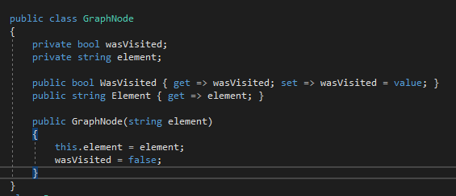
Building a graPH
Element can be a string as graphs aren’t about comparison, only the relationships between the nodes
Elements here are typically a vertex’s label
We track path movement through the boolean

Slide 8
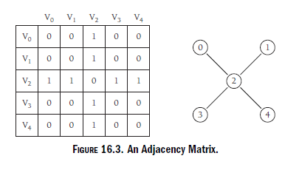
edges
The bread and butter of a graph
This is where the real information is
This is what makes it a meaningful structure
Adjacency matrix – a 2D array of edge representations
What is the problem with representing edges like this in large graphs?

Slide 9
The adjacency list
You can save space by creating an adjacency list
LinkedList of edge representations per every vertex
Storage of the adjacency list – array?
Have to resize the array on every insert or risk having a sparse array

Slide 10
Linkedlist of linkedlists
Our LinkedList for each vertex should be kept in its own Linked List
The first item (header) in each internal linked list will be the originating vertex
That then has a pointer to the next adjacency list
We can represent our entire graph this way

Slide 11
Linkedlist of linkedlists
Red
Fox
The
Big
Red
Fox
Fox
The
Big

Slide 12
Creating the big red fox graph
Let’s make the graph based off this adjacency list!

Slide 13
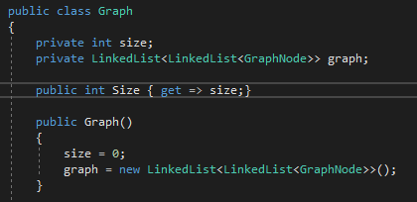
GRAPH BASICS

Slide 14
Inserting a vertex
Get a string and create a GraphNode from it
1
Create a new internal LinkedList of GraphNodes with the new node at the head
2
Insert the internal LinkedList into the graph (the LinkedList of LinkedLists)
3

Slide 15
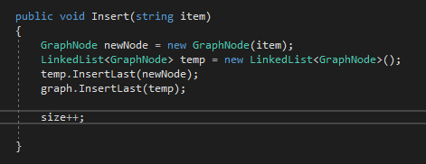
Inserting a vertex

Slide 16
Adding edges
Fetch the internal Linked List that links up with some string
1
If the header of the Linked List == item,we have the right list
2
Insert a new GraphNode into the internal list
3

Slide 17
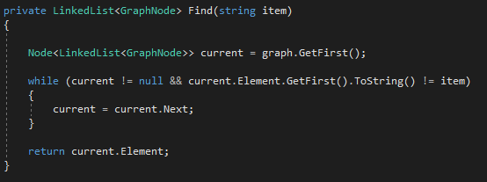
Finding the right list
Look through the header of each Linked List in the external linked list
Compare
Current = current.next

Slide 18

Adding edges

Slide 19

Adding bi-edges

Slide 20
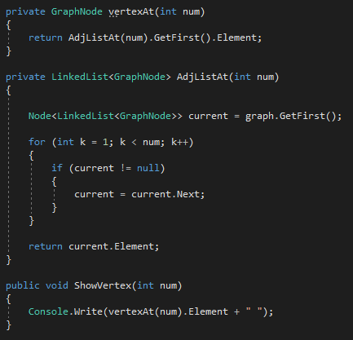
Finding and showing an adjacency list or vertex at n
Array indexing with a LinkedList
Useful because it allows an easier way to deal with indexing
Allows us to overload Adding Edges by specifying vertice numbers, not strings

Slide 21
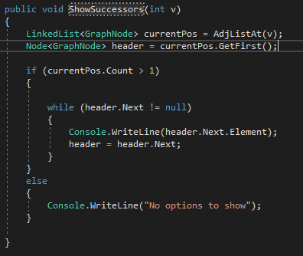
Showing the successors of any vertex v

Slide 22
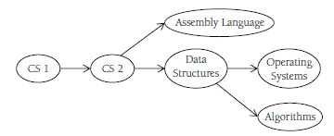
Topological sort
A topological sort is one of prerequisites
It shows the order in which vertices should be followed in a directed graph
Which courses here are concurrent?

Slide 23
Topological sort
Find a vertex that has no successors.
2
Add the vertex to a list of vertices.
3
Remove the vertex from the graph.
4
Repeat Step 2 until all vertices are removed
5
Traverse as far down the graph as we can
1

Slide 24

Finding the furthest leaf
We find a leaf if an Adjacency list length is 1
To find the furthest leaf, keep updating a variable as we find leaf nodes – the last update will be the last leaf
Return the int vertex of the leaf

Slide 25
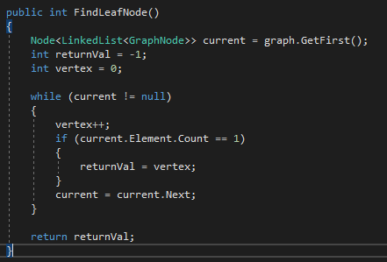
findleaf

Slide 26
Deleting a vertex
To delete a vertex from a graph, what two things need to happen in terms of the adjacency lists that makes up the graph?

Slide 27
Deleting a vertex
Delete the vertex’s adjacency list – this gets rid of all the edges
Delete all references to that vertex in other adjacency lists
Reduce graph size

Slide 28
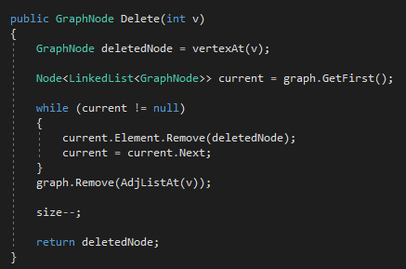
Deleting a vertex v

Slide 29

Topological sort
We use a stack to push to
The first leaf is lower in the graph
A topological sort should return a path through the graph, so the last pushed leaves will be the first out
Note: this does destroy the graph

Slide 30
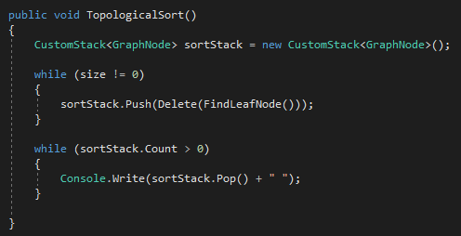
Topological sort

Slide 31
Searching a graph
Determines which vertices can be reached by another vertex
01
Depth first search (go deeper as much as we can)
02
Breadth first search (visit all nodes on the same level first)
03

Slide 32
Depth first search
Start at a vertex and follow the path down until you can’t anymore
01
Backtrack and follow a new path
02
Continue until all vertices are visited
03

Slide 33
Depth first search
First, pick a starting point, which can be any vertex.
Visit the vertex, push it onto a stack, and mark it as visited.
Then you go to the next vertex that is unvisited, push it on the stack, and mark it.
This continues until you reach the last vertex.
Then you check to see if the top vertex has any unvisited adjacent vertices.
If it doesn’t, then you pop it off the stack and check the next vertex.
If you find one, you start visiting adjacent vertices until there are no more, check for more unvisited adjacent vertices, and continue the process.
When you finally reach the last vertex on the stack and there are no more adjacent, unvisited vertices, you’ve performed a depth-first search.

Slide 34
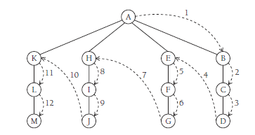
Depth first search

Slide 35
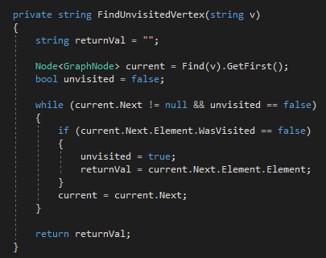
Finding the next unvisited vertex to move to

Slide 36
Visiting a vertex
When dealing with our list of adjacency lists, how do we definitively mark a vertex as visited
01
We have the WasVisited property to mark as true
02
Which node does that affect inside any given adjacency list?
03
What about the rest of the adjacency lists?
04

Slide 37
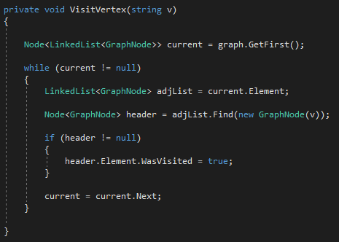
Visiting a vertex

Slide 38
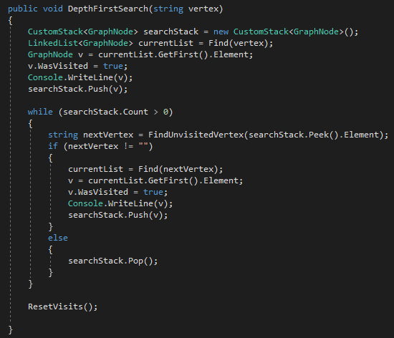
Depth first search

Slide 39
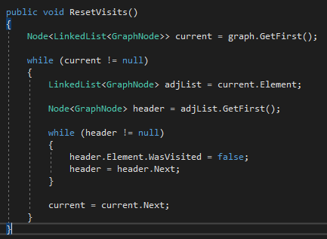
Resetting visited nodes

Slide 40
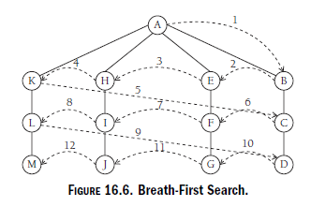
Breadth first search

Slide 41
Breadth first search
A breadth-first search starts at a first vertex and tries to visit vertices as close to the first vertex as possible.
Moves through a graph layer by layer
Sibling by sibling
Uses a queue, but otherwise similar to DFS

Slide 42
Breadth first search
Find an unvisited vertex that is adjacent to the current vertex
Mark it as visited, and add to a queue
If an unvisited, adjacent vertex can’t be found, remove a vertex from the queue (as long as there is a vertex to remove)
Make it the current vertex, and go back to Step 1
If the third step can’t be performed because the queue is empty, the algorithm is finished

Slide 43
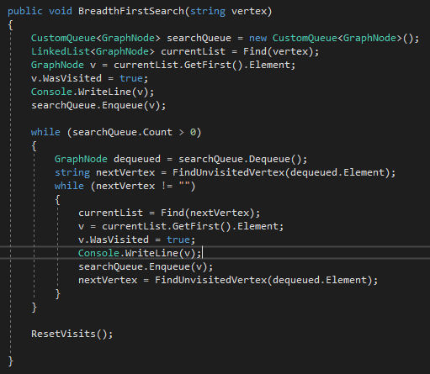
Breadth first search

Slide 44
Minimum spanning trees
What is the minimum number of edges needed in a graph so that every node connects to every other node
Creates a tree structure, as trees have no cycles
Spanning because the spans the entire graph
One graph can have multiple minimum spanning trees

Slide 45
Minimum spanning tree
Really just a traversal
Can use the basis of BFS or DFS
You just need to represent the edge as current vertex -> next vertex
Gives you a path through the graph that deals with visiting all the nodes
Some graphs have multiple “branches of minimum spanning trees
Some nodes can not be traversed to from other nodes

Slide 46
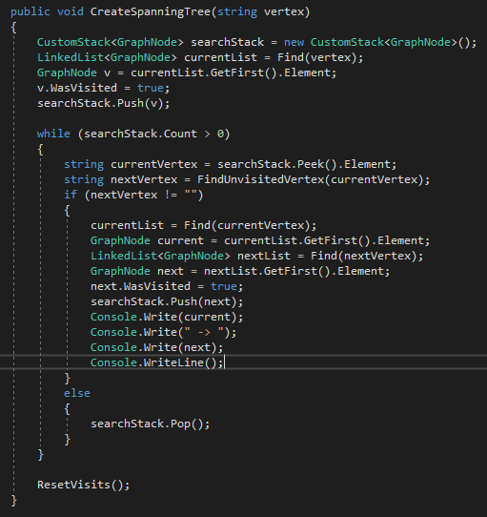
Minimum spanning trees

Slide 47
Shortest path algorithms
One of the core uses of graphs
Allows us to find the shortest path from A to B
Minimum spanning trees do some of this work but assume equal weights across all edges
As soon as each edge has a weight, we can determine via pathing the shortest path from A to B
Travelling salesman

Slide 48
Dijkstra’s algorithm
A shortest path algorithm to find the shortest path between a vertex and any other vertex in the graph
It’s a greedy algorithm
Greedy algorithm breaks a problem into pieces, or stages, determining the best solution at each stage, with each subsolution contributing to the final solution
The algorithm creates a “table” to track the length from a vertex A to any other vertex, with the length changing over multiple iterations

Slide 49
Weighted graphs
To work with Dijkstra, we need weighted graphs
1
Can use an array or LinkedList of edges
2
This is cumbersome for our purposes
3
Let’s look at our GraphNodes again
4

Slide 50
Our graph
Red
Fox
The
Big
Red
Fox
Fox
The
Big

Slide 51
The graphnodes in this graph
The vertical list are our “true” graphnodes – they are the actual created vertices on an insert
The horizontal list are “dummy” GraphNodes – they only exist to represent an edge from the start of the list to any dummy GraphNode
If these horizontal graphNodes don’t really represent GraphNodes, but rather edges, how can we change the GraphNode class to represent weight from “The” to “Fox” for example?

Slide 52
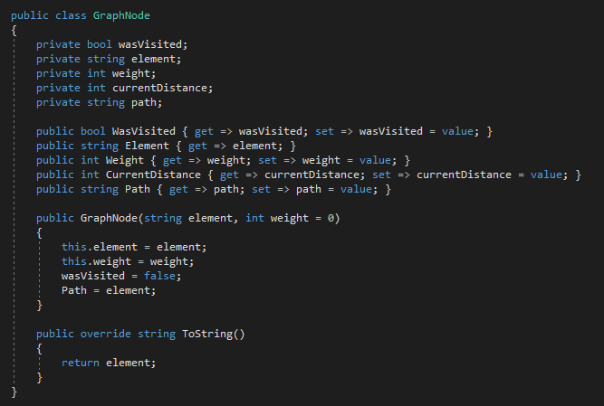
Weighted dummy nodes

Slide 53
The new graphnode class
Weight: Represents the weight of an edge. For non-Dummy GraphNodes, their Weight is 0, hence the default parameter to allow for non-weighted graphs
01
CurrentDistance: Used by Dijkstra to store the distance from the given starting node to that node: Primarily used by non-Dummy GraphNodes
02
Path: A path from a given starting node to a non-Dummy GraphNode to show shortest path
03

Slide 54

Adding a weighted edge

Slide 55
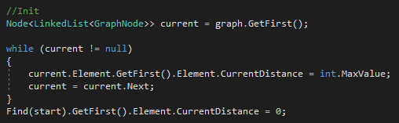
Dijkstra - initialisation
Set the distance of every vertex from the starting vertex an impossible number (can not be reached)
Set the distance from start to itself, 0
We set all our “real” GraphNodes to int.MaxValue, and the real node we start at 0

Slide 56

dijkstra
Create a structure which holds all vertices to be checked
Our graph already has this, but we initialize another pointer called ToBeChecked that is a graph
We get the initial size of the set (the number of vertices in the graph)
We run our main loop

Slide 57
Dijkstra in pseudocode
Set the distance of all vertices to infinity
1
Set the distance of the start vertex to 0
2
Add all vertices into an unchecked structure
3

Slide 58
Dijkstra in pseudocode
While the structure is not empty
{
Select a vertex in the structure with the smallest distance
Remove it from the structure (either physically or logically) – we are “visiting” this vertex
Decrease the size of the remaining ToBeChecked list
On that vertex (v), for each neighbour of that vertex we haven’t visited (u) (i.e. still “in” the ToBeChecked structure:
If the distance between start and this neighbor u > distance from start to v + the edge vu, set the current distance to be start -> v + vu
Remember, distance from start to neighbor u starts out at infinity
Set the neighbor u’s Path to be v’s path + u (appends the edge vu to v’s path)
}

Slide 59
Determining the node in tobechecked with the shortest distance
We are logically removing the vertex from the graph (visiting it and decreasing the remaining set’s size)
Otherwise standard loop through and mark each vertex against some current smallest

Slide 60
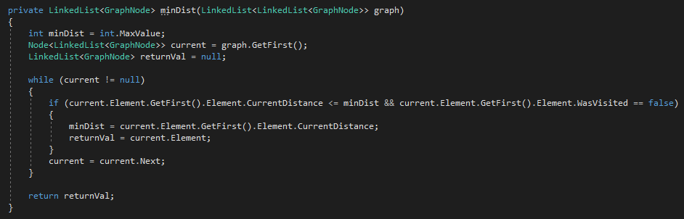
Determining the node in tobechecked with the shortest distance

Slide 61
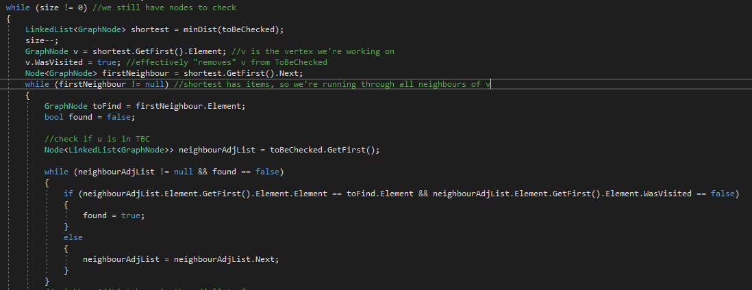
Finding a neighbor in tobechecked

Slide 62
Finding a neighbor in tobechecked
What is neighbourAdjList going to be set to if we CAN’T find it in ToBeChecked?
What do we do then?

Slide 63
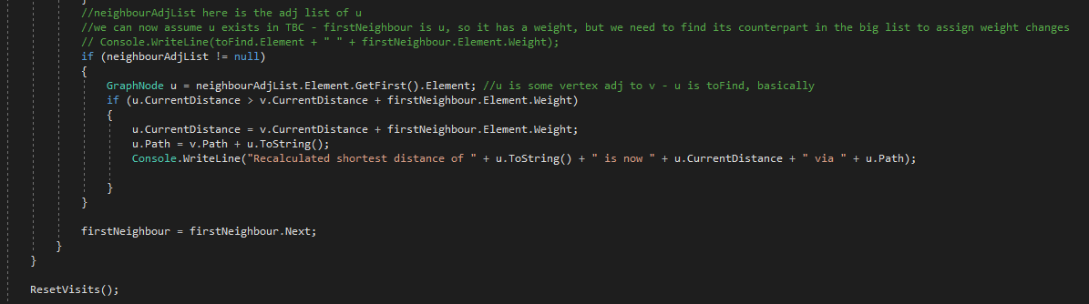
Updating the distance if the neighbour is in tobechecked

Slide 64
cleanup
That’s the entire loop
01
We now have distance from start to every other vertex
02
Let’s show that!
03
It’s saved in every real GraphNode’s CurrentDistance, along with the path
04

Slide 65
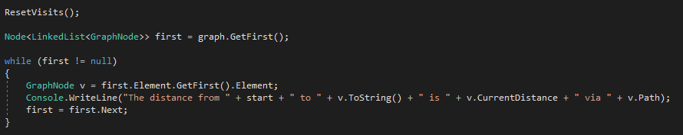
Showing all distances

Slide 66
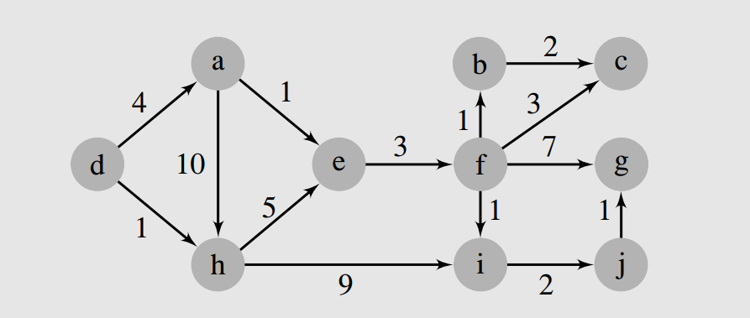
example

